Slide 1

B.Tech Computer Science and Engineering | BCSE497J - Project I
CareChain
Decentralized Electronic Health Record Platform
Student
Ashish Anil Sikaria (23BCI0218)
Faculty Guide
Dr. Selvi M
Review 1 | Panel 37 | SJT408

Slide 2
Aim
To design and implement a secure, patient-centric EHR platform where medical records are encrypted, stored off-chain on IPFS, and governed through blockchain-based consent.
The prototype enables controlled record sharing, verified practitioner access, and an auditable permission history without placing clinical files on-chain.

Slide 3
Abstract
CareChain addresses privacy, access-control, and auditability limitations in centralized electronic health record systems.
It combines a React role-based portal, Node.js/Express APIs, MongoDB metadata storage, AES-256-GCM encryption, IPFS storage through Pinata, and a Solidity smart contract for access control and audit events.
Patients control sharing; doctors access only authorized records; and administrators verify practitioners. Encrypted record references and access events are recorded on-chain, while clinical files remain off-chain.

Slide 4
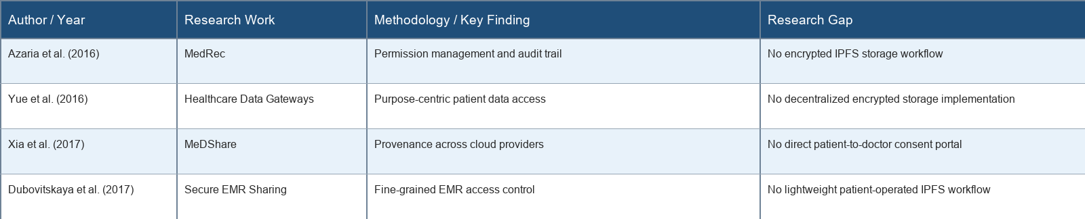


Literature Review

Slide 5
Research Gap
Centralized EHR repositories create a single high-value target for sensitive medical data.
Blockchain-only approaches are unsuitable for storing clinical files because of privacy and cost constraints.
IPFS storage requires encryption, key management, and a clear patient-controlled sharing workflow.
CareChain combines encrypted off-chain records with on-chain permissions and separate patient, doctor, and administrator portals.

Slide 6


Objectives
1. Build a patient portal for encrypted record upload, viewing, and selective sharing.
2. Implement doctor and administrator workflows for authorized access and practitioner verification.
3. Use a Solidity smart contract to manage permissions and produce immutable access events.
4. Keep clinical files off-chain through AES-256-GCM encryption and IPFS storage.
Identified SDG: SDG 3 - Good Health and Well-being
TRL 4: Technology validated in a laboratory environment
Outcome: Functional EHR prototype, source code, and test report

Slide 7
References
[1] A. Azaria et al., "MedRec: Using blockchain for medical data access and permission management," 2016 IEEE 2nd International Conference on Open and Big Data, pp. 25-30.
[2] X. Yue et al., "Healthcare Data Gateways: Found Healthcare Intelligence on Blockchain with Novel Privacy Risk Control," Journal of Medical Systems, vol. 40, no. 10, art. 218, 2016.
[3] Q. Xia et al., "MeDShare: Trust-Less Medical Data Sharing among Cloud Service Providers via Blockchain," IEEE Access, vol. 5, pp. 14757-14767, 2017.
[4] A. Dubovitskaya et al., "Secure and Trustable Electronic Medical Records Sharing using Blockchain," AMIA Annual Symposium Proceedings, pp. 650-659, 2017.

